Slide 1
Object-Oriented Analysis and Design
Session 2: Use cases
Mira Balaban and Arnon Sturm
Object-Oriented Analysis and Design

Slide 2
Requirements
Use Case Model And Contracts
Mira Balaban and Arnon Sturm
Object-Oriented Analysis and Design

Slide 3
Stages in a development cycle:
Understanding requirements – use cases.
Static modeling – Conceptual class diagram.
III. Identify operations and create their contracts.
IV. Assign responsibilities and design interaction diagrams.
Design level class diagrams, implementation and testing.
The stages are not performed in sequence.
Mira Balaban & Arnon Sturm

Slide 4
I. Understanding requirements – Use Cases
A use case is a narrative document – a story -- that describes the sequence of events of an actor using a system to complete a process.
A use case describes a typical interaction between an external entity (the actor – person, system, organization) to the system.
A use case describes multiple scenarios.
A scenario is a single path through the use case.
A use case depends on partial understanding of the requirements.
Use cases can be found by looking for their initiator actors.
Use case describes what the actors can do with the system.
Mira Balaban & Arnon Sturm

Slide 5
CASE STUDY: Point-of-Sale
A Point Of Sale (POS) is a computerized application used (in part) to record sales and handle payments. Typically used in a retail store.
Includes hardware and software.
Interfaces to service applications, e.g., tax calculator and inventory control.
Fault tolerant, e.g., remote services failure.
Support varied client-side terminals and interfaces.
Provide flexibility and customization -- different business rule processing, e.g., when a new sale is initiated.
Mira Balaban & Arnon Sturm

Slide 6
I. Understanding requirements – Use Cases
Finding use cases:
Choose system boundary: Decide what is outside the system.
For POS – cashier, payment authorization, inventory control, …
Identify primary actors.
Identify actor goals.
Define use cases that satisfy actor goals.
  What does the actor whishes to accomplish by the means of the system?
Mira Balaban & Arnon Sturm

Slide 7
I. Understanding requirements – Use Cases
What use cases are not ?
A common mistake about use cases:
A use case is a relatively large, end-to-end
process description, that typically includes
many steps or transactions; it is not normally
an individual step or activity.
For example: “print the receipt” is a step,
system function, not a use case.
Mira Balaban & Arnon Sturm

Slide 8
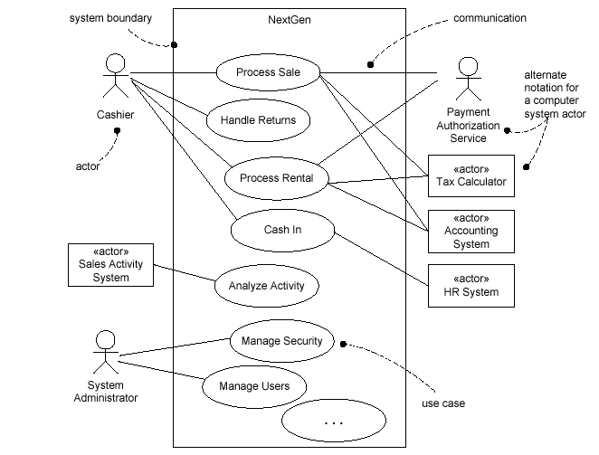
I. Understanding requirements – Use Cases
A partial use case diagram for the POS application:
Mira Balaban & Arnon Sturm

Slide 9
I. Understanding requirements – Use Cases
Visualization of use cases – use case
diagrams:
A use case diagram illustrates:
A set of use cases for a system.
Their actors.
Relationships between actors and use cases.
Inter-relationships between use cases.
Mira Balaban & Arnon Sturm

Slide 10
I. Understanding requirements – Use Cases
Essential versus real use cases:
Essential – conceptual specification of expanded use cases.
The customer identifies himself/herself.
Real – Concrete specification of the process.
The customer inserts his/her credit card and
types the code.
Only in design level.
Mira Balaban & Arnon Sturm

Slide 11
I. Understanding requirements – Use Cases
Example: Use case Process Sale, in a brief format.
A customer arrives at a checkout with items to purchase. The cashier uses the POS system to record each purchased item. The system presents a running total and line-item details. The customer enters payment information, which the system validates and records. The system updates inventory. The customer receives a receipt from the system and then leaves with the items.
Mira Balaban & Arnon Sturm

Slide 12
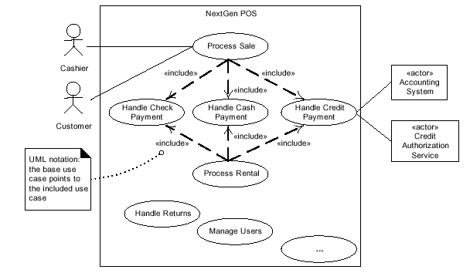
I. Understanding requirements – Use Cases
Relating Multiple Use Cases – The embedded alternatives
can be singled out as independent use cases.
Mira Balaban & Arnon Sturm

Slide 13
I. Understanding requirements – Use Cases
Relating Multiple Use Cases:
Alternatives are turned into full use cases.
The Buy Items use case “uses” the new use cases:
    Pay by Cash.
    Pay by Credit.
    Pay by Check.
In the use case document:
1. Insert an explicit reference in the alternatives section.
2. Add a section: Related Use Cases.
Mira Balaban & Arnon Sturm

Slide 14
I. Understanding requirements – Use Cases
Relationships between use cases:
<<uses>> (also called <<includes>>) is a relationship that denotes references between use cases.
<<extends>> is a relationship that denotes a “special case”:
Pay by
Check
Limits
“extends”
Exceeded
<<extends>> is used to emphasize similarity and diversion:
    Capture the normal use case.
    Describe variations.
Mira Balaban & Arnon Sturm

Slide 15
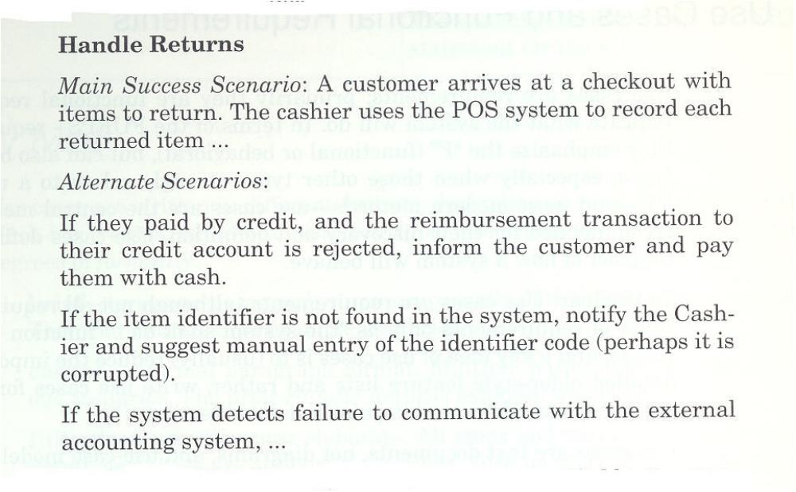
I. Understanding requirements – Use Cases
Example: Use case Handle Returns, in a casual format.
Mira Balaban & Arnon Sturm

Slide 16
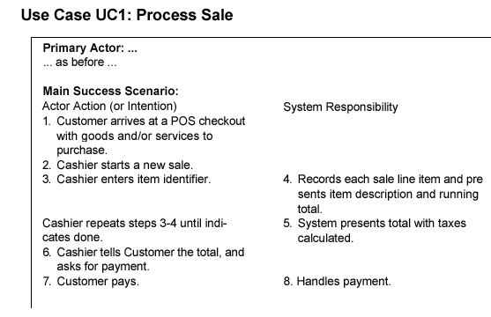
I. Understanding requirements – Use Cases
A two-column conversation format between an actor and
the system:
Mira Balaban & Arnon Sturm

Slide 17
I. Understanding requirements – Use Cases
The detailed format for use cases includes the main story of the
described process, the alternatives, and characterize the general
Situation. The usecases.org format (www.usecases.org) includes:
Name.
Primary actor.
Stakeholders and interests.
Preconditions.
Post conditions.
Main success scenario.
Alternative flows.
Special requirements.
Technology variations.
Frequency of occurrence.
Open issues.
Mira Balaban & Arnon Sturm

Slide 18
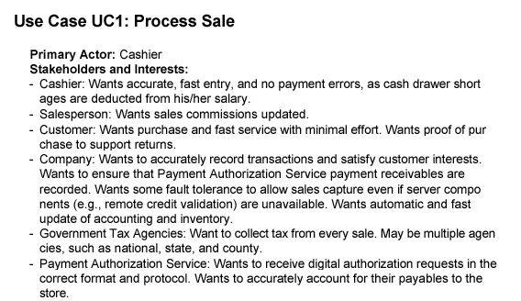
I. Understanding requirements – Use Cases
Example: Use case Process Sale, in a detailed format.
Mira Balaban & Arnon Sturm

Slide 19
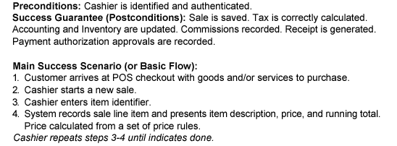
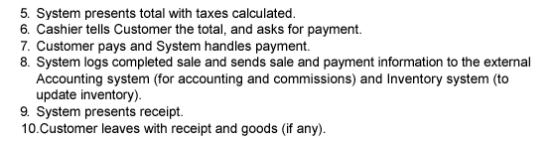
I. Understanding requirements – Use Cases
Mira Balaban & Arnon Sturm

Slide 20
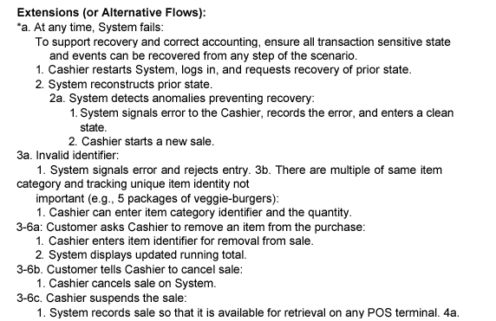
I. Understanding requirements – Use Cases
Mira Balaban & Arnon Sturm

Slide 21
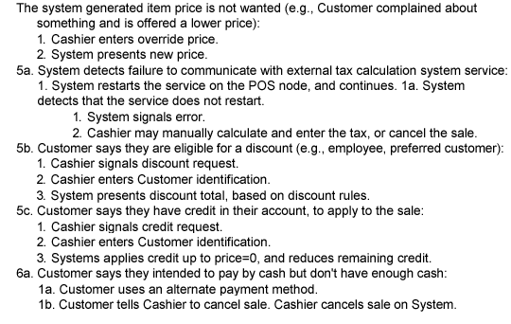
I. Understanding requirements – Use Cases
4a.
Mira Balaban & Arnon Sturm

Slide 22
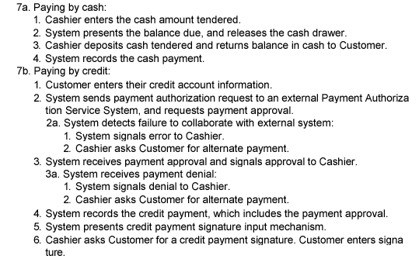
I. Understanding requirements – Use Cases
Mira Balaban & Arnon Sturm

Slide 23
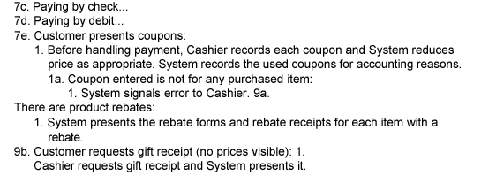
I. Understanding requirements – Use Cases
Mira Balaban & Arnon Sturm

Slide 24
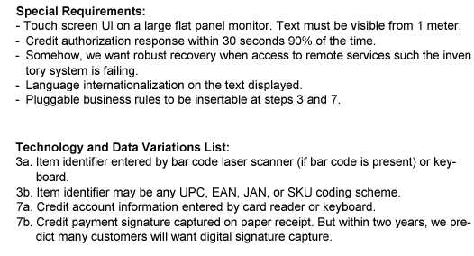
I. Understanding requirements – Use Cases
Mira Balaban & Arnon Sturm

Slide 25
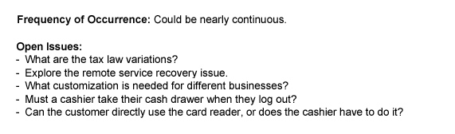
I. Understanding requirements – Use Cases
Mira Balaban & Arnon Sturm

Slide 26
I. Understanding requirements – Use Cases
Relating Multiple Use Cases – The embedded alternatives
can be singled out as independent use cases.
Mira Balaban & Arnon Sturm

Slide 27
I. Understanding requirements – Use Cases
Use Case Modeling Tips
Make sure that each use case describes a significant chunk of system usage that is understandable by domain experts, customers, and programmers
When defining use cases in text, use nouns and verbs accurately and consistently to help derive objects and messages for interaction diagrams
Factor out common usages that are required by multiple use cases
  If the usage is required use <<include>>
  If the base use case is complete and the usage may be optional, consider use <<extend>>
A use case diagram should
  contain only use cases at the same level of abstraction
  include only actors who are required
Complexity management
Mira Balaban & Arnon Sturm

Slide 28
Graphical Use Case Descriptions
Captures the interactions between actors and the system.
Sequence Diagram
x
y
z
a
b
c
Mira Balaban and Arnon Sturm
Object-Oriented Analysis and Design

Slide 29
Identify operations and create their contracts
Steps:
Identify system events that trigger system operations.
Create contracts for the identified operations.
Mira Balaban & Arnon Sturm

Slide 30
III. Identify operations and create their contracts
System events:
The system events and their associated operations are identified by observing the course of events in use cases.
Within a use case – follow the actions of actors that directly interact with the system.
For the simple Cash-only scenario of the Process Sale use case, the cashier is the only actor that directly interacts with the system. It generates the events:
  makeNewSale()
  enterItem(itemID, quantity)
  endSale()
  makePayment(amount)
Mira Balaban & Arnon Sturm

Slide 31
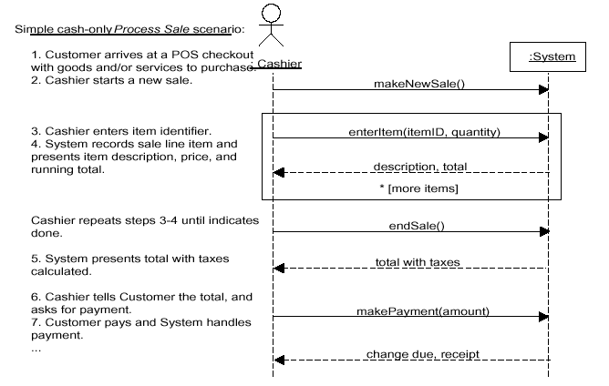
III. Identify operations and create their contracts
System events: The events can be described in a
System Sequence Diagram:
Mira Balaban & Arnon Sturm

Slide 32
III. Identify operations and create their contracts
System events:
The system events and their associated operations are identified by observing the course of events in use cases.
Within a use case – follow the actions of actors that directly interact with the system.
For the simple Cash-only scenario of the Process Sale use case, the cashier is the only actor that directly interacts with the system. It generates the events:
  makeNewSale()
  enterItem(itemID, quantity)
  endSale()
  makePayment(amount)
Mira Balaban & Arnon Sturm

Slide 33
III. Identify operations and create their contracts
System events: The events can be described in a
System Sequence Diagram:
Mira Balaban & Arnon Sturm

Slide 34
III. Identify operations and create their contracts
System sequence diagrams are important!
They serve for connecting the application logic layer
to other layers:
  If the actor is human – connection to the presentation
layer.
  If the actor is an external service – application interface.
They serve for implementing the use case scenarios.
Mira Balaban & Arnon Sturm

Slide 35
III. Identify operations and create their contracts
A contract is a document that describes what an operation
commits to achieve. A contract is expressed with:
pre-conditions – Assumptions about the state of the system at the beginning of the operation.
post-conditions – State of the system after the operation has finished:
    Instance creation and deletion.
    Attribute modification.
    Links formed and broken.
Goal: Create contracts for complex system operations.
Contracts are used to derive interaction diagrams for the operations.
Mira Balaban & Arnon Sturm

Slide 36
Understanding requirements – Use Cases
Mira Balaban & Arnon Sturm

Slide 37
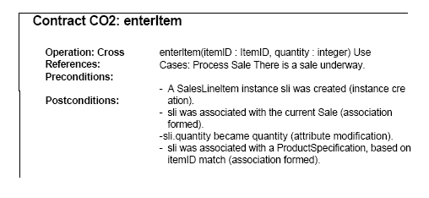
Identify operations and create their contracts
Create contracts:
Post conditions specify what must happen during a system
operation, but not how!
Mira Balaban & Arnon Sturm

Slide 38
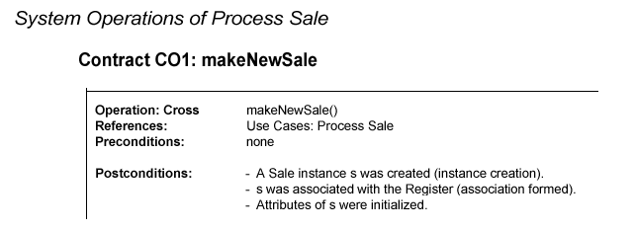
Identify operations and create their contracts
Create contracts – The POS example:
Mira Balaban & Arnon Sturm

Slide 39
Identify operations and create their contracts
Create contracts – The POS example:
Mira Balaban & Arnon Sturm

Slide 40
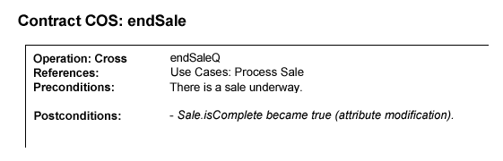
Identify operations and create their contracts
Create contracts – The POS example:
3:
Mira Balaban & Arnon Sturm

